Slide 1
Memory Management
Course: Operating Systems
Instructor: AWOTUNDE J. B.
Date: 3rd November 2025

Slide 2
Lecture Objectives
• Explain why several processes must be kept in memory.
• Describe the activities performed by the OS in memory management.
Notes:
Introduce the learning outcomes to students and connect them to broader OS memory handling concepts.

Slide 3
Memory Management Techniques
There are two Memory Management Techniques: Contiguous, and Non-Contiguous.
In Contiguous Technique, executing process must be loaded entirely in main-memory.
In contiguous memory allocation each process is contained in a single contiguous block of memory.
Memory is divided into several fixed size partitions. Each partition contains exactly one process.
Contiguous Technique can be divided into:
Fixed (or static) partitioning
Variable (or dynamic) partitioning
Notes:
Relate to page file in Windows and swap space in Linux.

Slide 4
Fixed Partitioning:
This is the oldest and simplest technique used to put more than one processes in the main memory.
In this partitioning, number of partitions (non-overlapping) in RAM are fixed but size of each partition may or may not be same.
As it is contiguous allocation, hence no spanning is allowed.
Here partitions are made before execution or during system configure.
Notes:
Relate to page file in Windows and swap space in Linux.

Slide 5
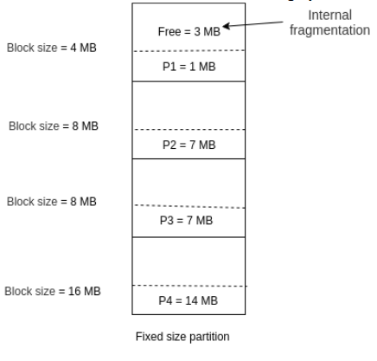
Notes:
Illustrate how fragmentation wastes space; connect to paging as a solution.

Slide 6
Advantages of Fixed Partitioning
Easy to implement:
Little OS overhead:
Disadvantages of Fixed Partitioning
Internal Fragmentation
External Fragmentation
Limit process size
Limitation on Degree of Multiprogramming
Notes:
Relate to page file in Windows and swap space in Linux.

Slide 7
Variable Partitioning
It is a part of Contiguous allocation technique.
It is used to alleviate the problem faced by Fixed Partitioning.
In contrast with fixed partitioning, partitions are not made before the execution or during system configure
Notes:
Relate to page file in Windows and swap space in Linux.

Slide 8
Various features associated with variable Partitioning
Initially RAM is empty and partitions are made during the run-time according to process’s need instead of partitioning during system configure.
The size of partition will be equal to incoming process.
The partition size varies according to the need of the process so that the internal fragmentation can be avoided to ensure efficient utilisation of RAM.
Number of partitions in RAM is not fixed and depends on the number of incoming process and Main Memory’s size.
Notes:
Relate to page file in Windows and swap space in Linux.

Slide 9
Advantages of Variable Partitioning
1. No Internal Fragmentation
2. No restriction on Degree of Multiprogramming
3. No Limitation on the size of the process
Notes:
Relate to page file in Windows and swap space in Linux.

Slide 10
Disadvantages of Variable Partitioning
1. Difficult Implementation
2. External Fragmentation
Notes:
Relate to page file in Windows and swap space in Linux.

Slide 11
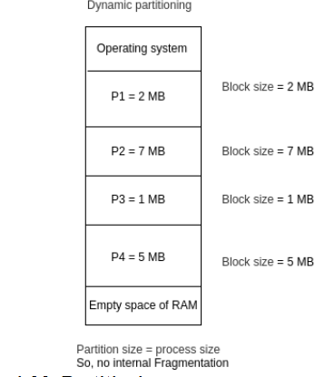
Notes:
Illustrate how fragmentation wastes space; connect to paging as a solution.

Slide 12
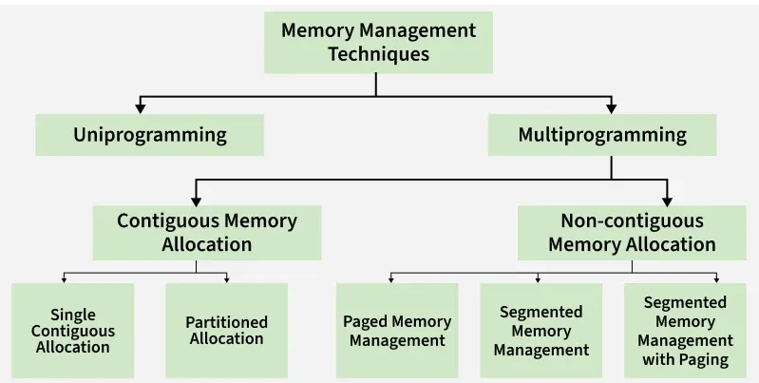
Notes:
Illustrate how fragmentation wastes space; connect to paging as a solution.

Slide 13
Memory Hardware Organisation
Lecture Objectives
At the end of this lecture, students should be able to:
Explain the detailed description of various ways of organizing memory hardware.
Understand that memory and the registers built into the processor are the only general-purpose storage that the CPU can access directly.
Notes:
Relate to page file in Windows and swap space in Linux.

Slide 14
Introduction to Memory Hardware Organisation
Memory hardware organization refers to how the memory system of a computer is structured, arranged, and managed to ensure fast and efficient data storage and retrieval.
It defines:
How data is stored, addressed, and accessed.
The relationship between memory units, registers, cache, main memory, and secondary storage.
Notes:
Relate to page file in Windows and swap space in Linux.

Slide 15
Components of Memory Hardware
Processor Registers
Small, high-speed storage locations within the CPU.
Hold data currently being processed or temporarily stored.
Examples: Accumulator (ACC), Instruction Register (IR), Program Counter (PC), Stack Pointer (SP).
Fastest type of memory but very limited in size.
Notes:
Relate to page file in Windows and swap space in Linux.

Slide 16
Cache Memory
A small, high-speed memory between the CPU and main memory.
Stores frequently accessed data and instructions to reduce access time.
Types:
L1 Cache: Built into the CPU chip.
L2 Cache: Located near or within the CPU module.
L3 Cache: Shared among cores in multi-core processors.
Notes:
Relate to page file in Windows and swap space in Linux.

Slide 17
Main Memory (Primary Memory or RAM)
Holds data and instructions that are actively in use.
Types:
Static RAM (SRAM): Used for cache.
SRAM is a type of memory that stores data using flip-flop circuits, typically made from 6 transistors per bit.
Unlike Dynamic RAM (DRAM), which needs constant refreshing, SRAM retains data as long as power is supplied—hence the term "static."
Notes:
Relate to page file in Windows and swap space in Linux.

Slide 18
Key Characteristics of SRAM
Fast access time: Much quicker than DRAM, making it ideal for cache.
No refresh needed: Data stays intact without periodic refresh cycles.
Lower density: Takes up more space per bit due to complex circuitry.
Higher cost: More expensive to produce than DRAM.
Volatile: Loses data when power is turned off.

Slide 19
Why SRAM Is Used for Cache
Cache memory is designed to be extremely fast and sits close to the CPU. Here's why SRAM is perfect for this role:
Feature | Benefit for Cache Memory
Fast speed | Keeps up with CPU operations
No refresh | Reduces latency and complexity
Stability | Reliable for frequent read/write
Low power (at idle) | Efficient for small, high-speed memory

Slide 20
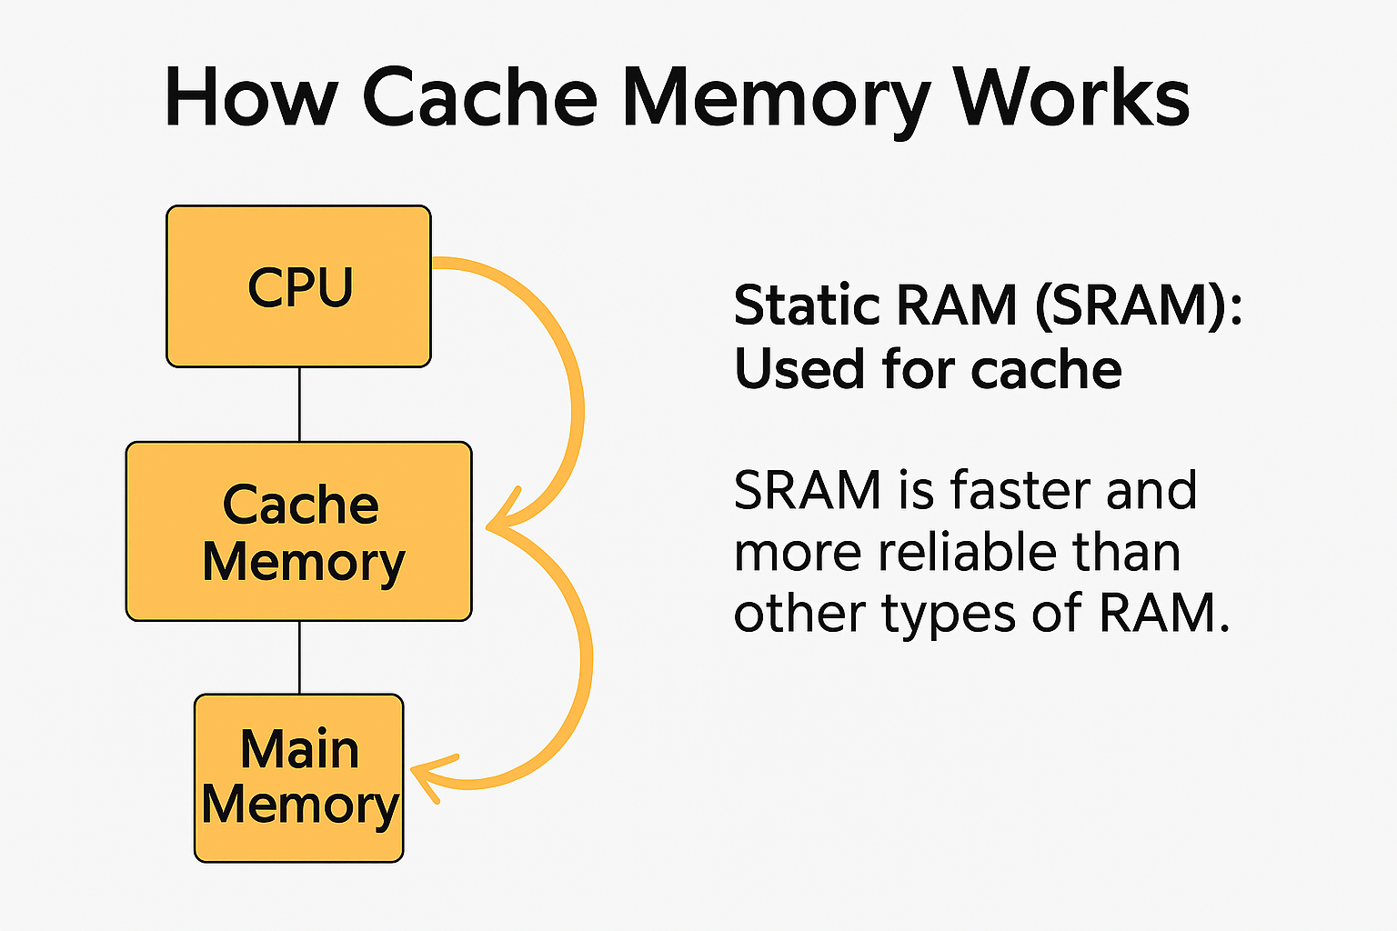

Slide 21
Dynamic RAM (DRAM): Used for main system memory.
It stores each bit of data in a memory cell composed of a capacitor and a transistor.
The capacitor holds an electrical charge to represent a binary value (1 or 0), but this charge leaks over time, requiring constant refreshing—typically every few milliseconds
Notes:
Relate to page file in Windows and swap space in Linux.

Slide 22
How DRAM Functions
Volatile Memory: DRAM loses all stored data when power is turned off.
Dynamic Nature: The need for frequent refreshing is what makes it "dynamic" as opposed to "static" RAM (SRAM), which doesn’t require refreshing.
Access Speed: While slower than SRAM, DRAM is still fast enough for system memory and is much cheaper to produce
Notes:
Relate to page file in Windows and swap space in Linux.

Slide 23
Why DRAM Is Used for Main System Memory
High Density: DRAM can pack more memory cells into a smaller space, allowing for larger memory capacities.
Cost Efficiency: It’s less expensive than SRAM, making it ideal for large-scale memory like that found in desktops, laptops, and servers.
Compatibility: DRAM is well-suited for the frequent read/write operations performed by CPUs during program execution
Notes:
Relate to page file in Windows and swap space in Linux.

Slide 24
Types of DRAM
SDRAM (Synchronous DRAM): Syncs with the system clock for faster performance.
DDR (Double Data Rate) SDRAM: Transfers data on both rising and falling edges of the clock signal. Versions include DDR2, DDR3, DDR4, and DDR5.
LPDDR (Low Power DDR): Used in mobile devices for energy efficiency.
Notes:
Relate to page file in Windows and swap space in Linux.

Slide 25
DRAM vs. SRAM
Feature | DRAM | SRAM
Speed | Slower | Faster
Cost | Cheaper | More expensive
Density | Higher | Lower
Refresh Needed | Yes | No
Usage | Main memory | Cache memory
Notes:
Relate to page file in Windows and swap space in Linux.

Slide 26
Secondary Storage
Non-volatile and used for long-term data storage.
Examples: Hard disk drives (HDD), solid-state drives (SSD), optical discs, flash drives.
Slower but much larger in capacity than main memory.
Notes:
Relate to page file in Windows and swap space in Linux.

Slide 27
Virtual Memory
A technique that allows the execution of processes that may not be completely in main memory.
Extends physical memory using disk space.
Managed by the operating system through paging and segmentation.
Notes:
Relate to page file in Windows and swap space in Linux.

Slide 28
Memory Organisation Hierarchy
Level | Type | Speed | Capacity | Cost per Bit
1 | CPU Registers | Fastest | Very Low | Highest
2 | Cache Memory | Very Fast | Low | High
3 | Main Memory (RAM) | Fast | Medium | Moderate
4 | Secondary Storage | Slow | High | Low
5 | Archival Storage (Tape, Cloud) | Very Slow | Very High | Lowest
This hierarchy balances speed, cost, and capacity, ensuring that frequently used data is kept close to the CPU.
Notes:
Relate to page file in Windows and swap space in Linux.

Slide 29
Memory Addressing and Access
Each memory location has a unique address.
The CPU uses address buses to locate data and data buses to transfer it.
Registers and main memory are the only storage units the CPU can directly access.
Accessing secondary or virtual memory requires the operating system’s intervention.
Notes:
Relate to page file in Windows and swap space in Linux.

